Slide 1


Binary Morphology
Dr. Kiran TALELE
 99 870 30 881

Slide 2
Dr. Kiran TALELE
@ Bharatiya Vidya Bhavans’ Sardar Patel Institute of Technology Andheri(w) Mumbai
Associate Professor, Electronics Engineering Department (1997)
Dean, Students, Alumni & External Relations (2022)
@ Sardar Patel Technology Business Incubator(SP-TBI),
Funded by Department of Science & Technology(DST),
Govt. of India
Co-ordinator (2015)
@ IEEE Bombay Section
Treasurer (2020)
Executive Committee Member (2015)
Kiran TALELE
‹#›

Slide 3
Morphology
Morphology: a branch of biology that deals with the form and structure of animals and plants
Morphological image processing is used to extract image components for representation and description of region shape, such as boundaries, skeletons, and the convex hull
‹#›
Dr. Kiran TALELE

Slide 4
Morphology
Morphological transformations are some simple operations based on the image shape. It is normally performed on binary images
It needs two inputs, one is our original image, second one is called structuring element or kernel which decides the nature of operation
Two basic morphological operators are Erosion and Dilation.
Then its variant forms like Opening and Closing
‹#›
Dr. Kiran TALELE

Slide 5
Structuring Elements
A structuring element is a shape mask used in
the basic morphological operations.
They can be any shape and size that is
digitally representable, and each has an origin
box
hexagon
disk
something
box(length,width) disk(diameter)
‹#›
Dr. Kiran TALELE

Slide 6


Basic morphological operations
Erosion
Dilation
‹#›
Dr. Kiran TALELE

Slide 7
Binary Morphology
Binary images often suffer from noise (specifically salt and-pepper noise)
Binary regions also suffer from noise (isolated black pixels in a white region). Can also have cracks, picket fence , etc.
Dilation and erosion are two binary morphological operations that can assist with these problems.
‹#›
Dr. Kiran TALELE

Slide 8
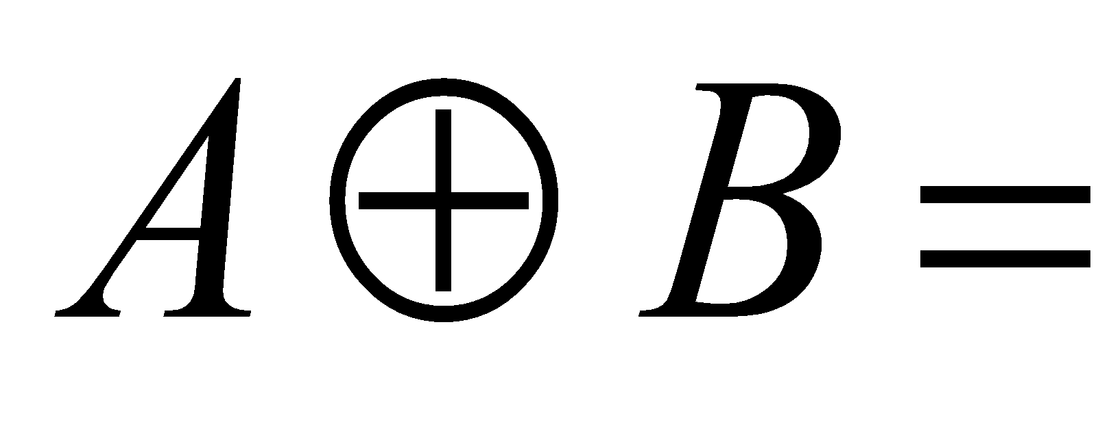
(1) Dilation
Dilation is used for expanding an element A by using structuring element B
The dilation operator takes two pieces of data as input
A binary image A, which is to be dilated
2. A structuring element B (or kernel B) , which determines the behavior of the morphological operation
Dilation of A by Structuring element B is defined as
{ P : Such that p=a+b for every a ∈ A and b ∈ B }
‹#›
Dr. Kiran TALELE

Slide 9
Dilation . . . .
Dilation expands the connected sets of 1s of a binary image.
It can be used for
1. growing features
2. filling holes and gaps
‹#›
Dr. Kiran TALELE

Slide 10
Dilation example
A =
1
B =
1
1
1
Structuring Element
1
1
1
Input Image
Dilation of A by Structuring element B is defined as
{ P : Such that p=a+b for every a ∈ A and b ∈ B }
‹#›
Dr. Kiran TALELE

Slide 11
Dilation example…
0 1 2 3 4
0 1
A =
0
1
2
3
4
1
B =
1
1
0
1
1
1
1
B = (0,0) , (0,1)
A = (0,1),
(1,1)
, (2,1), (2,2), (3,0)
‹#›
Dr. Kiran TALELE

Slide 12

Dilation example
0 1 2 3 4
0 1
0 1 2 3 4
A =
0
1
2
3
4
1
B =
1
1
0
1
2
3
4
1
0
1
1
B = (0,0), (0,1)
1
1
1
1
1
1
A = (0,1), (1,1),(2,1),(2,2),(3,0)
A B = (0,1) + (0,0) = (0,1)
‹#›
Dr. Kiran TALELE

Slide 13
Dilation example
0 1 2 3 4
0 1
0 1 2 3 4
A =
0
1
2
3
4
1
B =
1
1
0
1
2
3
4
1
1
0
1
1
1
B = (0,0), (0,1)
1
1
1
1
1
1
1
1
A = (0,1), (1,1),(2,1),(2,2),(3,0)
A B =
(0,1) + (0,0)= (0,1) (1,1) + (0,0)= (1,1) (2,1) + (0,0)= (2,1) (2,2) + (0,0)= (2,2) (3,0) + (0,0)= (3,0) | (0,1) + (0,1)= (0,2) (1,1) + (0,1)= (1,2) (2,1) + (0,1)= (2,2) (2,2) + (0,1)= (2,3) (3,0) + (0,1)= (3,1)

Slide 14
Dilation explained pixel by pixel
A =
1
B =
1
1
1
1
1
1
1
1
1
Denotes origin of B i.e. its (0,0)
1
1
1
1
1
1
Input Image
Output Image
‹#›
Dr. Kiran TALELE

Slide 15



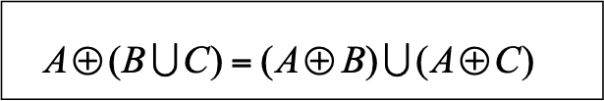

Mathematical Properties of Dilation
Commutative
Associative
Linearity
Translation
‹#›
Dr. Kiran TALELE

Slide 16
Question: Suppose that the structuring element is a 3x3 square with the origin at its center evaluate the new image
B =
1
1
1
B = { (-1,-1), (0,-1), (1,-1),
(-1,0), (0,0), (1,0),
( 1,1), (0,1), (1,1) }
1
1
1
1
1
1
1
1
1
A =
1
1
1
1
1
1
1
‹#›
Dr. Kiran TALELE

Slide 17
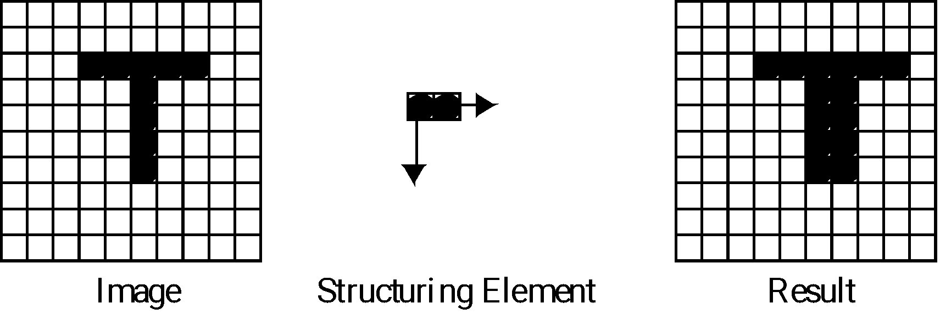
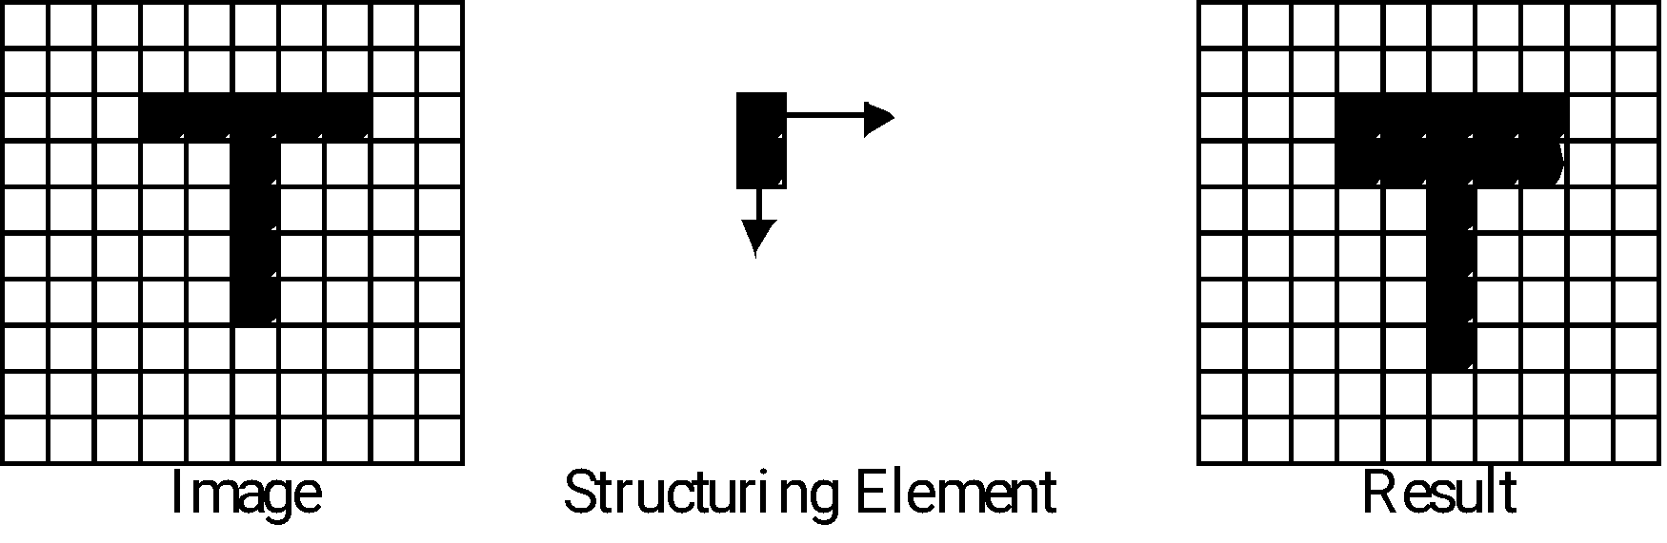
Length 5
Length 6

Slide 18
Dilation Example-2
Input Image
Output Image
Structuring Element
‹#›
Dr. Kiran TALELE
Notes:
‹#›

Slide 19
Main Applications of Dilation
Expand shapes
Fills in holes, crack, valleys between spiky regions
Smoothes object boundaries.
Adds an extra outer ring of pixels onto object boundary, ie, object becomes slightly larger.
(sets background pixels adjacent to object's contour to object's value)
smoothes small negative grey level regions
‹#›
Dr. Kiran TALELE

Slide 20
(2) Erosion
Erosion is used for shrinking an element A by using structuring element B
The Erosion operator takes two pieces of data as input
A binary image A, which is to be eroded
A structuring element B (or kernel B) , which determines the behavior of the morphological operation
Erosion of A by Structuring element B is defined as
A B = { P : Such that p+b ∈ A for every b ∈ B }
‹#›
Dr. Kiran TALELE

Slide 21
Erosion example
A =
1
B =
1
1
1
Structuring Element
1
1
1
Input Image
Erosion of A by Structuring element B is defined as
A B = { P : Such that p+b ∈ A for every b ∈ B }
‹#›
Dr. Kiran TALELE

Slide 22
Erosion Example…
0 1 2 3 4
0 1
A =
0
1
2
3
4
1
B =
1
1
0
1
1
1
1
B = (0,0) , (0,1)
A = (0,1),
(1,1)
, (2,1), (2,2), (3,0)
‹#›
Dr. Kiran TALELE

Slide 23
Erosion Example . . .
0 1 2 3 4
0 1
0 1 2 3 4
A =
0
1
2
3
4
1
B =
1
1
A B =
0
1
2
3
4
0
1
B = (0,0), (0,1)
1
1
1
To find p A B
∈
Let p = (0,0)
Find p+b for every b∈B
(0,0) + (0,0)= (0,0)
(0,0) + (0,1)= (0,1)
Here, p+b ∉ A
Therefore p ∉ (A B )
∉

Slide 24
Erosion Example . . .
0 1 2 3 4
0 1
0 1 2 3 4
A =
0
1
2
3
4
1
B =
1
1
A B =
0
1
2
3
4
0
1
B = (0,0), (0,1)
1
1
1
To find p A B
∈
(2) Let p = (0,1)
Find p+b for every b∈B
(0,1) + (0,0)= (0,1)
(0,1) + (0,1)= (0,2)
Here, p+b ∉ A
Therefore p ∉ (A B )
∉

Slide 25
Erosion Example . . .
0 1 2 3 4
0 1
0 1 2 3 4
A =
0
1
2
3
4
1
B =
1
1
A B =
0
1
2
3
4
0
1
B = (0,0), (0,1)
1
1
1
1
To find p A B
∈
(3) Let p = (2,1)
Find p+b for every b∈B
(2,1) + (0,0)= (2,1)
(2,1) + (0,1)= (2,2)
Here, p+b ∈ A
Therefore p ∈ (A B )
∉

Slide 26
Erosion explained pixel by pixel
A =
1
B =
A B =
1
1
1
1
1
Denotes origin of B i.e. its (0,0)
1
1
Input Image
Output Image
‹#›
Dr. Kiran TALELE

Slide 27
Erosion Example-2
Erosion(B,S) takes a binary image B, places the origin
of structuring element S over every pixel position, and
ORs a binary 1 into that position of the output image only if
every position of S (with a 1) covers a 1 in B
0 0 1 1 0
0 0 1 1 0
0 0 1 1 0
1 1 1 1 1
0 0 0 0 0
0 0 1 1 0
0 0 1 1 0
0 0 0 0 0
1
1
1
erode
B
S
B S
‹#›
Dr. Kiran TALELE

Slide 28
Erosion Example-3
Input Image
Output Image
Structuring Element
Notes:
‹#›

Slide 29
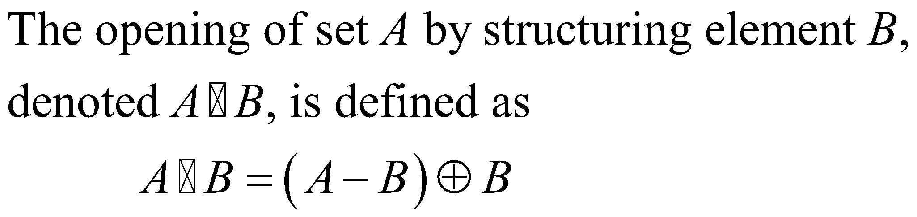
(3) Opening
‹#›
Dr. Kiran TALELE

Slide 30
Opening Example . . .
0 1 2 3 4. 5 6
0 1
A =
0
1
2
3
1
1
B =
0
1
1
1
1
1
1
1
1
1
1
1
1
1
1
1
1
1
1
1
‹#›
Dr. Kiran TALELE

Slide 31
Opening Example . . .
0 1 2 3 4. 5 6
0 1
A =
0
1
2
3
1
1
B =
0
1
1
1
1
1
1
1
1
1
1
1
1
1
1
1
1
1
1
1
0 1 2 3 4. 5 6
0 1 2 3 4. 5 6
A B =
A B=
0
1
2
3
0
1
2
3
1
1
1
1
1
1
1
1
1
1
1
1
1
1
1
1
1
1
1
1
1
1
1
1
1
1
‹#›
Dr. Kiran TALELE

Slide 32
Opening operation smooths the object coastline eliminating small peaks
Opening Example . . .
0 1 2 3 4. 5 6
0 1
A =
0
1
2
3
1
1
B =
0
1
1
1
1
1
1
1
1
1
1
1
1
1
1
1
1
1
1
1
1
1
1
0 1 2 3 4. 5 6
A B=
0
1
2
3
1
1
1
1
1
1
1
1
1
1
1
1
1
1
1
‹#›
Dr. Kiran TALELE

Slide 33
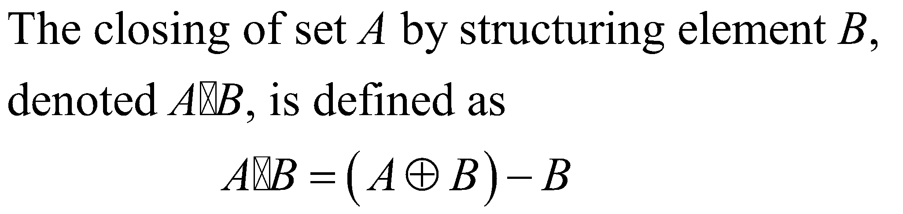
(4) Closing
‹#›
Dr. Kiran TALELE

Slide 34
Closing Example . . .
0 1 2 3 4. 5 6
0 1
A =
0
1
2
3
1
1
B =
0
1
1
1
1
1
1
1
1
1
1
1
1
1
1
1
1
1
1
1
0 1 2 3 4. 5 6 7
0 1 2 3 4. 5 6
A O B=
0
1
2
3
0
1
2
3
1
1
1
1
1
1
1
1
1
1
1
1
1
1
1
1
1
1
1
1
1
1
1
1
1
1
1
1
1
1
1
1
1
1
1
1
1
1
1
1
1
1
1
1
1
1
1
1
1
1
‹#›
Dr. Kiran TALELE

Slide 35
Closing operation fills small holes and smooths the object by filling narrow gaps
Closing Example . . .
0 1 2 3 4. 5 6
0 1
A =
0
1
2
3
1
1
B =
0
1
1
1
1
1
1
1
1
1
1
1
1
1
1
1
1
1
1
1
1
1
1
0 1 2 3 4. 5 6
A O B=
0
1
2
3
1
1
1
1
1
1
1
1
1
1
1
1
1
1
1
1
1
1
1
1
1
1
1
‹#›
Dr. Kiran TALELE

Slide 36
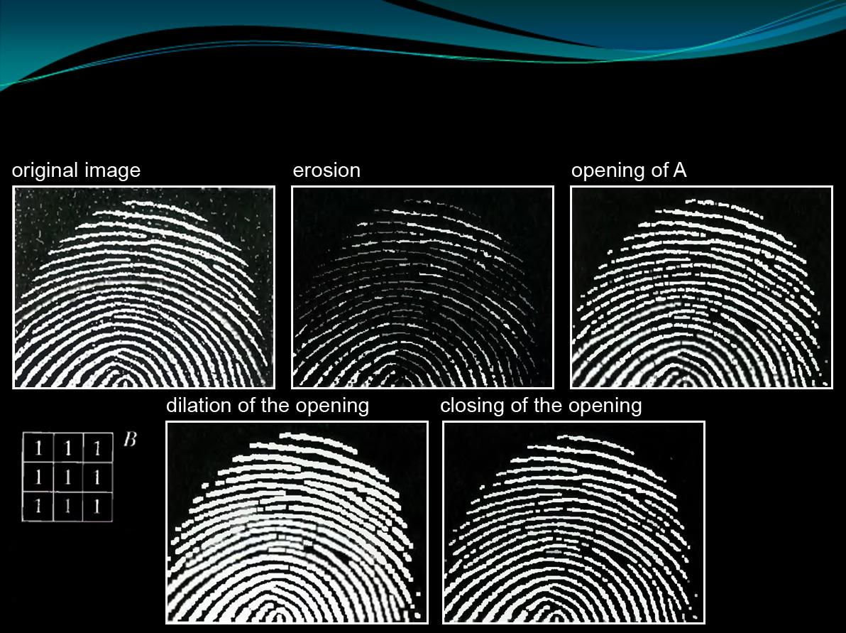
Use of opening and closing for morphological filtering

Slide 37
Boundary Detection
Boundary of Object A is defined by
Boundary(A) = A – ( )
A B
‹#›
Dr. Kiran TALELE

Slide 38
Ex-1
0 1 2 3 4 5 6 7 8 9
A =
0
1
2
3
4
1
1
1
1
1
1
1
1
B =
1
1
1
1
1
1
1
1
1
1
1
1
1
1
1
1
1
1
1
1
1
1
1
1
1
1
1
1
1
1
1
1
1
1
1
1
1
1
1
1
1
1
1
1
1
1
1
0 1 2 3 4 5 6 7 8 9
A B =
0
1
2
3
4
1
1
1
1
1
1
1
1
1
1
1
1
1
1
1
1
1
1

Slide 39
0 1 2 3 4 5 6 7 8 9
A =
0
1
2
3
4
1
1
1
1
1
1
1
1
B =
1
1
1
1
1
1
1
1
1
1
1
1
1
1
1
1
1
1
1
1
1
1
1
1
1
1
1
1
1
1
1
1
1
1
1
1
1
1
1
1
1
1
1
1
1
1
1
0 1 2 3 4 5 6 7 8 9
B(A)=
0
1
2
3
4
1
1
1
1
1
1
1
1
1
1
1
1
1
1
1
1
1
1
1
1
1
1
1
1
1
1
1
1
1
1
‹#›
Dr. Kiran TALELE

Slide 40
Ex-1
0 1 2 3 4 5 6 7 8 9
0
1
2
3
4
A =
1
1
1
1
1
1
1
1
B =
1
1
1
1
1
1
1
1
1
1
1
1
1
1
1
1
1
1
1
1
1
1
1
1
1
1
1
1
1
1
1
1
1
1
1
1
1
1
1
1
1
1
1
1
1
1
1
0 1 2 3 4 5 6 7 8 9
B(A)=
0
1
2
3
4
All boundary
pixels are Four
point connected
1
1
1
1
1
1
1
1
1
1
1
1
1
1
1
1
1
1
1
1
1
1
1
1
1
1
1
1
1
1
‹#›
Dr. Kiran TALELE

Slide 41
Boundary Detection. Example-2
Boundary of Object A is defined by
Boundary(A) = A – ( )
A B
‹#›
Dr. Kiran TALELE

Slide 42
Ex-2
0 1 2 3 4. 5 6 7 8 9
0
1
2
3
4
A =
1
1
1
1
1
1
1
1
B =
1
1
1
1
1
1
1
1
1
1
1
1
1
1
1
1
1
1
1
1
1
1
1
1
1
1
1
1
1
1
1
1
1
1
1
1
1
1
1
1
1
1
1
A B =
0 1 2 3 4 5 6 7 8 9
0
1
2
3
4
1
1
1
1
1
1
1
1
1
1
1
1
1
1
1
1
1
1
1
‹#›
Dr. Kiran TALELE

Slide 43
0 1 2 3 4 5 6 7 8 9
A =
0
1
2
3
4
1
1
1
1
1
1
1
1
B =
1
1
1
1
1
1
1
1
1
1
1
1
1
1
1
1
1
1
1
1
1
1
1
1
1
1
1
1
1
1
1
1
1
1
1
1
1
1
1
1
1
1
1
0 1 2 3 4 5 6 7 8 9
B(A)=
0
1
2
3
4
1
1
1
1
1
1
1
1
1
1
1
1
1
1
1
1
1
1
1
1
1
1
1
1
1
1
1
‹#›
Dr. Kiran TALELE

Slide 44
0 1 2 3 4 5 6 7 8 9
0
1
2
3
4
A =
1
1
1
1
1
1
1
B =
1
B =
1
1
1
1
1
1
1
1
1
1
1
1
1
1
1
1
1
1
1
1
1
1
1
1
1
1
1
1
1
1
1
1
1
1
1
1
1
1
1
1
1
1
1
0 1 2 3 4 5 6 7 8 9
B(A)=
0
1
2
3
4
All boundary
pixels are Eight
point connected
1
1
1
1
1
1
1
1
1
1
1
1
1
1
1
1
1
1
1
1
1
1
1
1
1
1
1
1
‹#›
Dr. Kiran TALELE

Slide 45
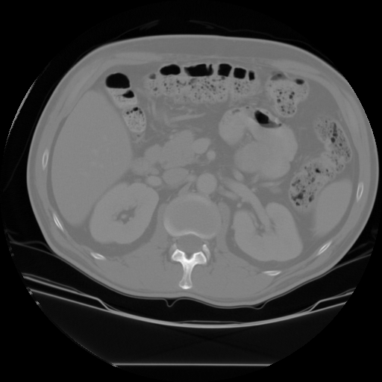
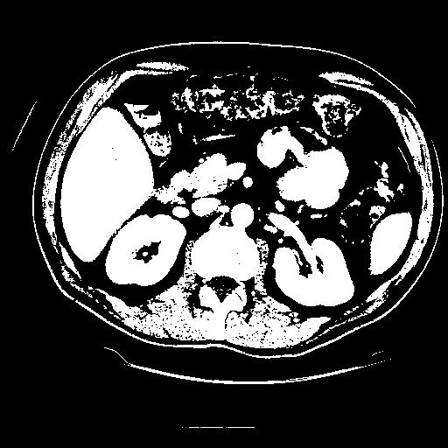


Connected Components Labeling
Once you have a binary image, you can identify and
then analyze each connected set of pixels.
The connected components operation takes in a binary image
and produces a labeled image in which each pixel has the
integer label of either the background (0) or a component.
original thresholded opening+closing components
‹#›
Dr. Kiran TALELE

Slide 46
Region Filling
It is defined as X = ( X_{k-1} B ) ∩ A^{c}
Where X_{o} is any pixel inside the region
A is input image and
B is structuring element such that
B =
1
1
1
1
The process is applied iteratively and
it ends when
X_{k} = X_{k-1}
1
The final result is given by A_{o}
A_{o} = A U X_{n}
‹#›
Dr. Kiran TALELE

Slide 47
Example :
A =
B =
1
1
1
1
1
A=
Xo=
A^{c} =
1
1
1
1
1
1
1
1
1
1
1
1
1
1
1
1
1
‹#›
Dr. Kiran TALELE

Slide 48
A=
Xo=
A^{c} =
1
1
1
1
1
1
1
1
1
1
1
1
1
1
1
1
1
B =
Step-1 : For k = 1, X₁ = ( X_{o} B ) ∩ A^{c}
(i) X_{o} B =
1
(ii) X₁ =
1
1
1
1
1
1
‹#›
Dr. Kiran TALELE

Slide 49
A=
X₁ =
A^{c} =
1
1
1
1
1
1
1
1
1
1
1
1
1
1
1
1
1
1
B =
Step-2 : For k = 2, X₂ = ( X₁ B ) ∩ A^{c}
(i) X₁ B =
1
(i) X₂ =
1
1
1
1
1
1
1
1
1
1
‹#›
Dr. Kiran TALELE

Slide 50
A=
X₂ =
A^{c} =
1
1
1
1
1
1
1
1
1
1
1
1
1
1
1
1
1
1
1
B =
Step-3 : For k = 3, X₃ = ( X₂ B ) ∩ A^{c}
(i) X₂ B =
1
(i) X₃ =
1
1
1
1
1
1
1
1
1
1
1
1
‹#›
Dr. Kiran TALELE

Slide 51
A=
X₃ =
A^{c} =
1
1
1
1
1
1
1
1
1
1
1
1
1
1
1
1
1
1
1
Step-4 : Here, X₃ = X₂ Find Output Image. A₀ = A U X₃
A₀ =
1
1
1
1
1
1
1
1
1
1
1
1
1
‹#›
Dr. Kiran TALELE

Slide 52

Hit or Miss Transform
The Hit or Miss Transform is defined as,
*
Where A is input image and B is an object to be searched.
W is an object that completely encloses B
‹#›
Dr. Kiran TALELE

Slide 53

Example :
Hit or Miss Transform….
A =
 | 1 | 1 | 1
 | 1 | 1 | 1 | 1
 | 1 |  | 1
 | 1 | 1 | 1
1
1
1
1
Matching Successful 🡺 Hit
W =
0 | 0 | X
0 | 1 | 1
X | 1 | X
*
1
Hit. 🡺
‹#›
Dr. Kiran TALELE

Slide 54
Example :
Hit or Miss Transform….
A =
 | 1 | 1 | 1
 | 1 | 1 | 1 | 1
 | 1 |  | 1
 | 1 | 1 | 1
1
1
1
1
1
1
Matching NOT Successful 🡺 Miss
W =
0 | 0 | X
0 | 1 | 1
X | 1 | X
*
1
‹#›
Dr. Kiran TALELE

Slide 55
Example :
Hit or Miss Transform….
A =
 | 1 | 1 | 1
 | 1 | 1 | 1 | 1
 | 1 |  | 1
 | 1 | 1 | 1
1
1
1
1
1
Matching NOT Successful 🡺 Miss
W =
0 | 0 | X
0 | 1 | 1
X | 1 | X
*
1
‹#›
Dr. Kiran TALELE

Slide 56
Example :
Hit or Miss Transform….
A =
 | 1 | 1 | 1
 | 1 | 1 | 1 | 1
 | 1 |  | 1
 | 1 | 1 | 1
Matching NOT Successful 🡺 Miss
W =
0 | 0 | X
0 | 1 | 1
X | 1 | X
*
1
‹#›
Dr. Kiran TALELE

Slide 57
Example :
Hit or Miss Transform….
A =
 | 1 | 1 | 1
 | 1 | 1 | 1 | 1
 | 1 |  | 1
 | 1 | 1 | 1
Matching NOT Successful 🡺 Miss
W =
0 | 0 | X
0 | 1 | 1
X | 1 | X
*
1
‹#›
Dr. Kiran TALELE

Slide 58
Example :
Hit or Miss Transform….
A =
 | 1 | 1 | 1
 | 1 | 1 | 1 | 1
 | 1 |  | 1
 | 1 | 1 | 1
Matching NOT Successful 🡺 Miss
W =
0 | 0 | X
0 | 1 | 1
X | 1 | X
*
1
‹#›
Dr. Kiran TALELE

Slide 59
Example :
Hit or Miss Transform….
A =
 | 1 | 1 | 1
 | 1 | 1 | 1 | 1
 | 1 |  | 1
 | 1 | 1 | 1
Matching NOT Successful 🡺 Miss
W =
0 | 0 | X
0 | 1 | 1
X | 1 | X
*
1
‹#›
Dr. Kiran TALELE

Slide 60
Example :
Hit or Miss Transform….
A =
 | 1 | 1 | 1
 | 1 | 1 | 1 | 1
 | 1 |  | 1
 | 1 | 1 | 1
Matching NOT Successful 🡺 Miss
W =
0 | 0 | X
0 | 1 | 1
X | 1 | X
*
1
‹#›
Dr. Kiran TALELE

Slide 61
Example :
Hit or Miss Transform….
A =
 | 1 | 1 | 1
 | 1 | 1 | 1 | 1
 | 1 |  | 1
 | 1 | 1 | 1
Matching NOT Successful 🡺 Miss
W =
0 | 0 | X
0 | 1 | 1
X | 1 | X
*
1
Upper
Corner
Detected
‹#›
Dr. Kiran TALELE

Slide 62
Hit or Miss Transform….
Following masks can be used to find different convex corner points in images.
W₁ =
W₂ =
X | 1 | X
0 | 1 | 1
0 | 0 | X
X | 1 | X
1 | 1 | 0
X | 0 | 0
W₃=
W₄ =
X | 0 | 0
1 | 1 | 0
X | 1 | X
0 | 0 | X
0 | 1 | 1
X | 1 | X
After obtaining the locations of corners in each orientation, we can then simply OR all these images together to get the final result showing the locations of all right angle convex corners in any orientation.
‹#›
Dr. Kiran TALELE

Slide 63
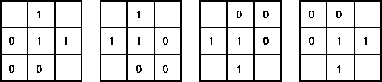

Hit-and-miss example: corner detection
Structuring Elements representing four corners.
Apply each Structuring Element.
Use OR operation to combine the four results.

Slide 64
HW Detect all corners in the image A
Hit or Miss Transform….
A =
 | 1 | 1 | 1
 | 1 | 1 | 1
 | 1 |  | 1
 | 1 | 1 | 1
‹#›
Dr. Kiran TALELE

Slide 65
Hit or Miss Transform…
The hit-and-miss operation is performed in much the same way as other morphological operators, by translating the origin of the structuring element to all points in the image, and then comparing the structuring element with the underlying image pixels.
If the foreground and background pixels in the structuring element exactly match foreground and background pixels in the image, then the pixel underneath the origin of the structuring element is set to the foreground color.
If it doesn't match, then that pixel is set to the background color.
‹#›
Dr. Kiran TALELE

Slide 66

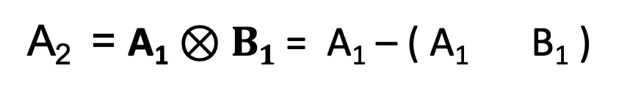
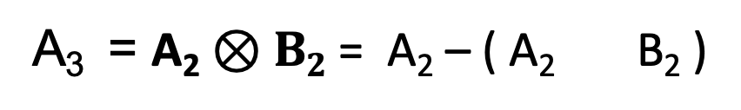
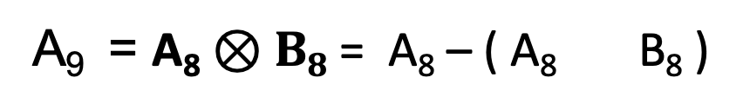
Thinning
The Thinning of Binary Image A by B is defined as
*
A₁ = A
*
*
. . . .
. . . .
*
‹#›
Dr. Kiran TALELE

Slide 67
Thinning Operators are as given below….
B₁ =
B₂ =
B₃ =
X | 1 | X
1 | 1 | 1
X
1 | 1
1 | 1 | X
1 | X
1 | 1
1 | X
B₄ =
B₅ =
B₆ =
X | 1 | 1
 | 1 | 1
 |  | X
1 | 1 | X
1 | 1
X
1 | 1 | 1
X | 1 | X
B₇ =
B₈ =
 |  | X
 | 1 | 1
X | 1 | 1
 | X | 1
 | 1 | 1
 | X | 1
‹#›
Dr. Kiran TALELE

Slide 68
Example of Thinning :
A =
1 | 1 | 1 | 1 | 1 | 1
1 | 1 | 1 | 1 | 1 | 1
 |  | 1 | 1
 |  | 1 | 1
 |  | 1 | 1
Step-1 :
A₁ = A
‹#›
Dr. Kiran TALELE

Slide 69
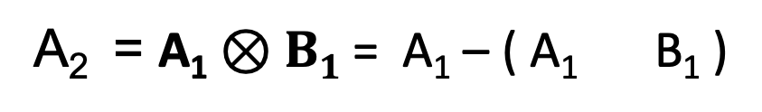
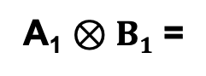
A₁ =
1 | 1 | 1 | 1 | 1 | 1
1 | 1 | 1 | 1 | 1 | 1
 |  | 1 | 1
 |  | 1 | 1
 |  | 1 | 1
B₁ =
X | 1 | X
1 | 1 | 1
1
1
1
1
1
1
Step-2 :
*
A₂ =
1 |  |  |  |  | 1
1 | 1 | 1 | 1 | 1 | 1
 |  | 1 | 1
 |  | 1 | 1
 |  | 1 | 1
1
1
‹#›
Dr. Kiran TALELE

Slide 70
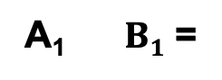
A₁ =
1 | 1 | 1 | 1 | 1 | 1
1 | 1 | 1 | 1 | 1 | 1
 |  | 1 | 1
 |  | 1 | 1
 |  | 1 | 1
B₁ =
X | 1 | X
1 | 1 | 1
1
1
1
1
1
1
Step-2 :
*
*
A₂ =
1 |  |  |  |  | 1
1 | 1 | 1 | 1 | 1 | 1
 |  | 1 | 1
 |  | 1 | 1
 |  | 1 | 1
1
1
‹#›
Dr. Kiran TALELE

Slide 71
A₁ =
1 | 1 | 1 | 1 | 1 | 1
1 | 1 | 1 | 1 | 1 | 1
 |  | 1 | 1
 |  | 1 | 1
 |  | 1 | 1
B₁ =
X | 1 | X
1 | 1 | 1
1
1
1
1
Step-2 :
*
*
 | 1 | 1 | 1 | 1
A₂ =
1 |  |  |  |  | 1
1 | 1 | 1 | 1 | 1 | 1
 |  | 1 | 1
 |  | 1 | 1
 |  | 1 | 1
‹#›
Dr. Kiran TALELE

Slide 72
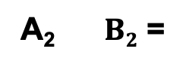
A₂ =
1 |  |  |  |  | 1
1 | 1 | 1 | 1 | 1 | 1
 |  | 1 | 1
 |  | 1 | 1
 |  | 1 | 1
B₂ =
X
1 | 1
1 | 1 | X
Step-3 :
*
*
A₃ =
1 |  |  |  |  | 1
1 | 1 | 1 | 1 | 1 | 1
 |  | 1 | 1
 |  | 1 | 1
 |  | 1 | 1
NO
Result
‹#›
Dr. Kiran TALELE

Slide 73
A₂ =
1 |  |  |  |  | 1
1 | 1 | 1 | 1 | 1 | 1
 |  | 1 | 1
 |  | 1 | 1
 |  | 1 | 1
B₂ =
X
1 | 1
1 | 1 | X
Step-3 :
*
*
A₃ =
1 |  |  |  |  | 1
1 | 1 | 1 | 1 | 1 | 1
 |  | 1 | 1
 |  | 1 | 1
 |  | 1 | 1
NO
Result
‹#›
Dr. Kiran TALELE

Slide 74
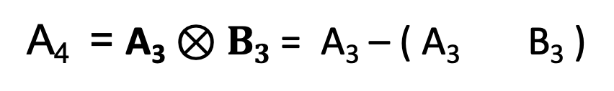
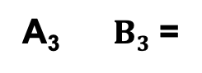
A₃ =
1 |  |  |  |  | 1
1 | 1 | 1 | 1 | 1 | 1
 |  | 1 | 1
 |  | 1 | 1
 |  | 1 | 1
B₃ =
1 | X
1 | 1
1 | X
Step-4 :
*
*
A₄ =
1 |  |  |  |  | 1
1 | 1 | 1 | 1 | 1 | 1
 |  | 1 | 1
 |  | 1
 |  | 1 | 1
1
‹#›
Dr. Kiran TALELE

Slide 75
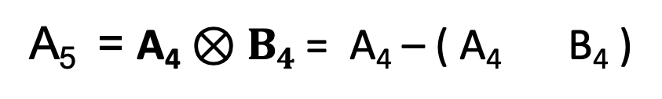
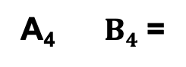
A₄ =
1 |  |  |  |  | 1
1 | 1 | 1 | 1 | 1 | 1
 |  | 1 | 1
 |  | 1
 |  | 1 | 1
B₄ =
1 | 1 | X
1 | 1
X
Step-5 :
*
*
A₅ =
1 |  |  |  |  | 1
1 | 1 | 1 | 1 | 1 | 1
 |  | 1
 |  | 1
 |  | 1 | 1
1
‹#›
Dr. Kiran TALELE

Slide 76
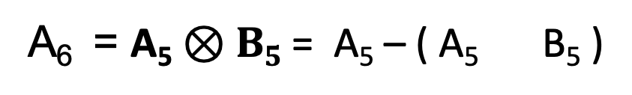
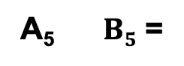
A₅ =
1 |  |  |  |  | 1
1 | 1 | 1 | 1 | 1 | 1
 |  | 1
 |  | 1
 |  | 1 | 1
B₅ =
1 | 1 | 1
X | 1 | X
Step-6 :
*
*
A₆ =
1 |  |  |  |  | 1
1 | 1 | 1 | 1 | 1 | 1
 |  | 1
 |  | 1
 |  | 1 | 1
NO
Result
‹#›
Dr. Kiran TALELE

Slide 77
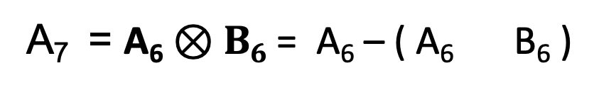
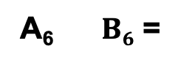
A₆ =
1 |  |  |  |  | 1
1 | 1 | 1 | 1 | 1 | 1
 |  | 1
 |  | 1
 |  | 1 | 1
B₆ =
X | 1 | 1
 | 1 | 1
 |  | X
Step-7 :
*
*
A₇ =
1 |  |  |  |  | 1
1 | 1 | 1 | 1 | 1 | 1
 |  | 1
 |  | 1
 |  | 1 | 1
NO
Result
‹#›
Dr. Kiran TALELE

Slide 78
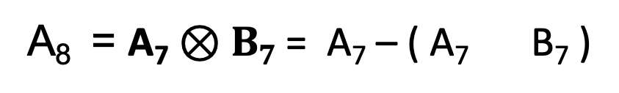
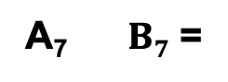
A₇ =
1 |  |  |  |  | 1
1 | 1 | 1 | 1 | 1 | 1
 |  | 1
 |  | 1
 |  | 1 | 1
B₇ =
 | X | 1
 | 1 | 1
 | X | 1
Step-8 :
*
*
A₈ =
1 |  |  |  |  | 1
1 | 1 | 1 | 1 | 1 | 1
 |  | 1
 |  | 1
 |  | 1 | 1
NO
Result
‹#›
Dr. Kiran TALELE

Slide 79
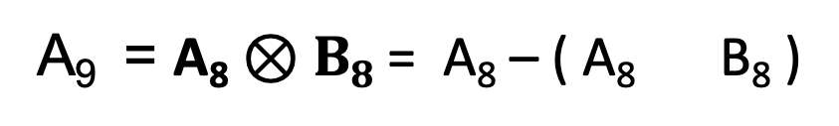
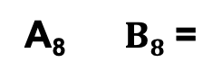
A₈ =
1 |  |  |  |  | 1
1 | 1 | 1 | 1 | 1 | 1
 |  | 1
 |  | 1
 |  | 1 | 1
B₈ =
 |  | X
 | 1 | 1
X | 1 | 1
Step-9 :
*
*
A₉ =
1 |  |  |  |  | 1
1 | 1 | 1 | 1 | 1 | 1
 |  | 1
 |  | 1
 |  | 1 | 1
NO
Result
‹#›
Dr. Kiran TALELE

Slide 80
Result :
A =
1 | 1 | 1 | 1 | 1 | 1
1 | 1 | 1 | 1 | 1 | 1
 |  | 1 | 1
 |  | 1 | 1
 |  | 1 | 1
A₉ =
1 |  |  |  |  | 1
1 | 1 | 1 | 1 | 1 | 1
 |  | 1
 |  | 1
 |  | 1 | 1
Input Image
Output Image
‹#›
Dr. Kiran TALELE

Slide 81

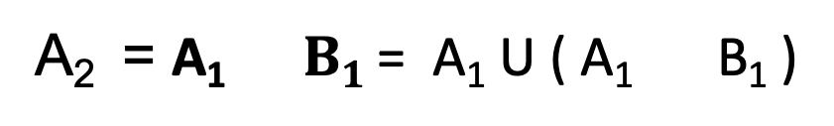
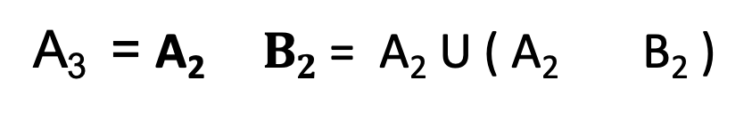
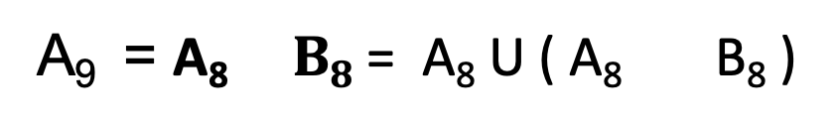
Thickening
The Thickening of Image A by B is given as
.
*
A₁ = A
.
*
.
*
. . . .
. . . .
.
*
‹#›
Dr. Kiran TALELE

Slide 82
Thickening Operators are as given below….
B₁ =
B₂ =
B₃ =
1 | 1 | 1
X | o | X
X | 1 | 1
 | o | 1
 |  | X
 | X | 1
 | o | 1
 | X | 1
B₄ =
B₅ =
B₆ =
X
1 | o
1 | 1 | X
 |  | X
 | o | 1
X | 1 | 1
X | o | X
1 | 1 | 1
B₇ =
B₈ =
1 | 1 | X
1 | o
X
1 | X
1 | o
1 | X
‹#›
Dr. Kiran TALELE

Slide 83

Thickening
Example of Thickening :
A =
 | 1 | 1 | 1
 |  | 1
 |  | 1
 |  | 1
 | 1 | 1 | 1
The Thickening of Image A by B is given as
.
*
‹#›
Dr. Kiran TALELE

Slide 84
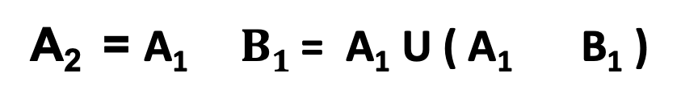
Step-1 :
A₁ = A
B₁ =
1 | 1 | 1
X | o | X
A₁ =
 | 1 | 1 | 1
 |  | 1
 |  | 1
 |  | 1
 | 1 | 1 | 1
Step-2 :
.
*
A₁ B₁ =
A₂ =
*
 | 1 | 1 | 1
 |  | 1
 |  | 1
 |  | 1
 | 1 | 1 | 1
NO
Result
‹#›
Dr. Kiran TALELE

Slide 85
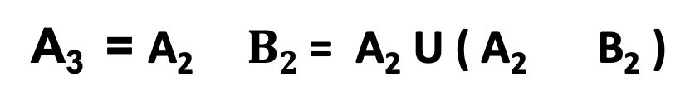
A₂ =
 | 1 | 1 | 1
 |  | 1
 |  | 1
 |  | 1
 | 1 | 1 | 1
B₂ =
X | 1 | 1
 | o | 1
 |  | X
Step-3 :
.
*
A₂ B₂ =
A₃ =
*
 | 1 | 1 | 1
 |  | 1
 |  | 1
 |  | 1
 | 1 | 1 | 1
1
1
Hit 🡺
‹#›
Dr. Kiran TALELE

Slide 86
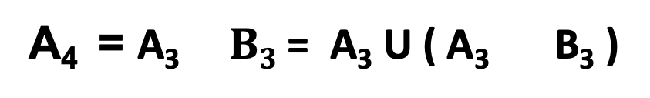
A₃ =
 | 1 | 1 | 1
 | 1 | 1
 |  | 1
 |  | 1
 | 1 | 1 | 1
B₃ =
 | X | 1
 | o | 1
 | X | 1
Step-4 :
.
*
A₃ B₃ =
A₄ =
*
 | 1 | 1 | 1
 | 1 | 1
 |  | 1
 |  | 1
 | 1 | 1 | 1
1
1
Hit 🡺
‹#›
Dr. Kiran TALELE

Slide 87
A₃ =
 | 1 | 1 | 1
 | 1 | 1
 |  | 1
 |  | 1
 | 1 | 1 | 1
B₃ =
 | X | 1
 | o | 1
 | X | 1
Step-4 :
.
*
A₃ B₃ =
A₄ =
*
 | 1 | 1 | 1
 | 1 | 1
 |  | 1
 |  | 1
 | 1 | 1 | 1
1
1
1
1
Hit 🡺
‹#›
Dr. Kiran TALELE

Slide 88
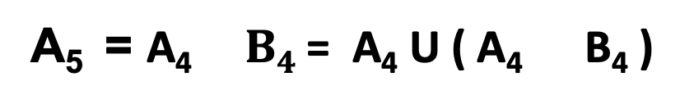
A₄ =
 | 1 | 1 | 1
 | 1 | 1
 | 1 | 1
 | 1 | 1
 | 1 | 1 | 1
B₄ =
 |  | X
 | o | 1
X | 1 | 1
Step-5 :
1
.
*
A₄ B₄ =
A₅ =
*
 | 1 | 1 | 1
 | 1 | 1
 |  | 1
 |  | 1
 | 1 | 1 | 1
Miss
1
1
‹#›
Dr. Kiran TALELE

Slide 89

A₅ =
 | 1 | 1 | 1
 | 1 | 1
 | 1 | 1
 | 1 | 1
 | 1 | 1 | 1
B₅ =
X | o | X
1 | 1 | 1
Step-6 :
.
*
A₅ B₅ =
A₆ =
*
 | 1 | 1 | 1
 | 1 | 1
 |  | 1
 |  | 1
 | 1 | 1 | 1
Miss
1
1
‹#›
Dr. Kiran TALELE

Slide 90
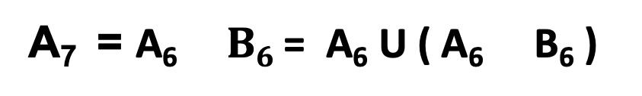
A₆ =
 | 1 | 1 | 1
 | 1 | 1
 | 1 | 1
 | 1 | 1
 | 1 | 1 | 1
B₆ =
X
1 | o
1 | 1 | X
Step-7 :
.
*
A₆ B₆ =
A₇ =
*
 | 1 | 1 | 1
 | 1 | 1
 |  | 1
 |  | 1
 | 1 | 1 | 1
1
1
1
1
Hit 🡺
‹#›
Dr. Kiran TALELE

Slide 91

A ₇=
 | 1 | 1 | 1
 | 1 | 1
 | 1 | 1
 | 1 | 1 | 1
 | 1 | 1 | 1
B₇ =
1 | X
1 | o
1 | X
Step-8 :
.
*
A₇ B₇ =
A₈ =
*
 | 1 | 1 | 1
 | 1 | 1
 |  | 1
 |  | 1
 | 1 | 1 | 1
1
1
Hit 🡺
1
1
1
Hit 🡺
1
1
‹#›
Dr. Kiran TALELE

Slide 92

A ₈ =
 | 1 | 1 | 1
 | 1 | 1 | 1
 | 1 | 1 | 1
 | 1 | 1 | 1
 | 1 | 1 | 1
B₈ =
1 | 1 | X
1 | o
X
Step-9 :
.
*
A₈ B₈ =
A₉ =
*
 | 1 | 1 | 1
 | 1 | 1
 |  | 1
 |  | 1
 | 1 | 1 | 1
1
Miss
1
1
1
1
‹#›
Dr. Kiran TALELE

Slide 93
Thickening
HW. Perform Thickening Transformation on the input image given below :
A =
1 |  |  |  |  | 1
1 | 1 | 1 | 1 | 1 | 1
 |  | 1
 |  | 1
 |  | 1 | 1
‹#›
Dr. Kiran TALELE

Slide 94




Dr. Kiran TALELE
Academic : PhD
Professional :
Dean-Students, Alumni & External Relations @ Bharatiya Vidya Bhavans’ Sardar Patel Institute of Technology (SP-IT), Mumbai
Head-Academic Relation @ Sardar Patel Technology Business Incubator (SP-TBI), Mumbai
Treasurer-IEEE Bombay Section
091-9987030881
kiran.talele@spit.ac.in / ktvtalele@gmail.com
https://www.linkedin.com/in/k-t-v-talele/
www.facebook.com/Kiran-Talele-1711929555720263
Stay Connected
‹#›
‹#›

